Slide 1
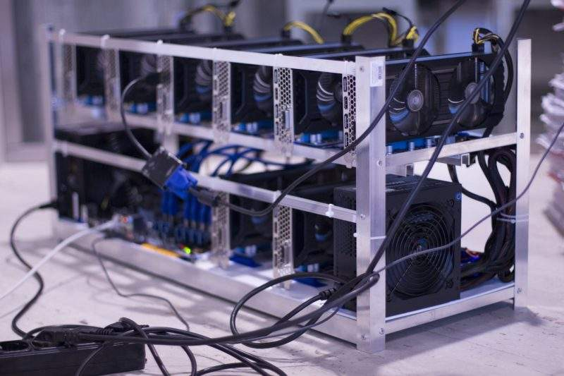
Consensus Mechanisms

Slide 2
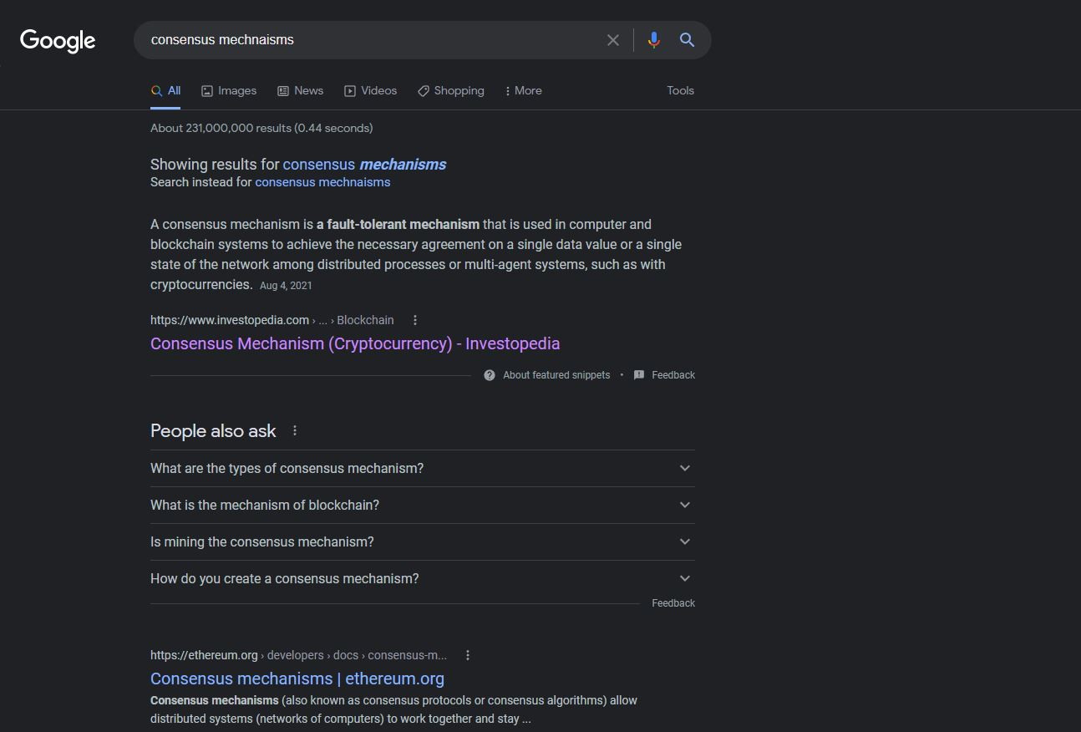

Slide 3

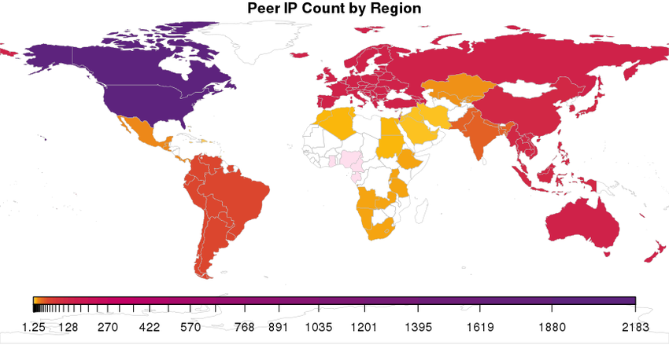
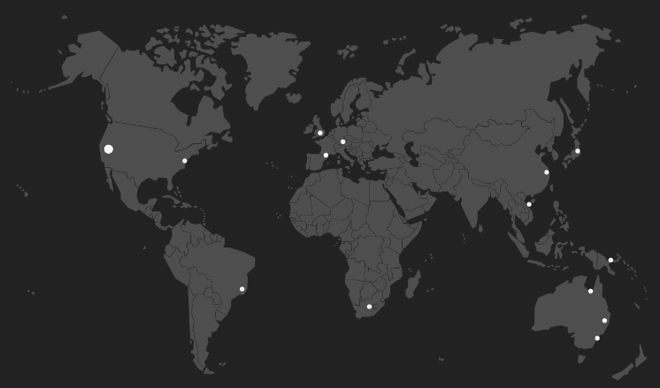


Slide 4
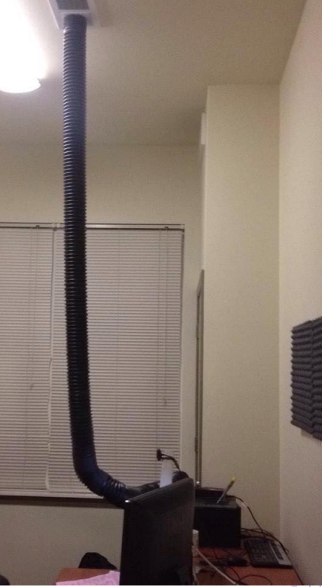
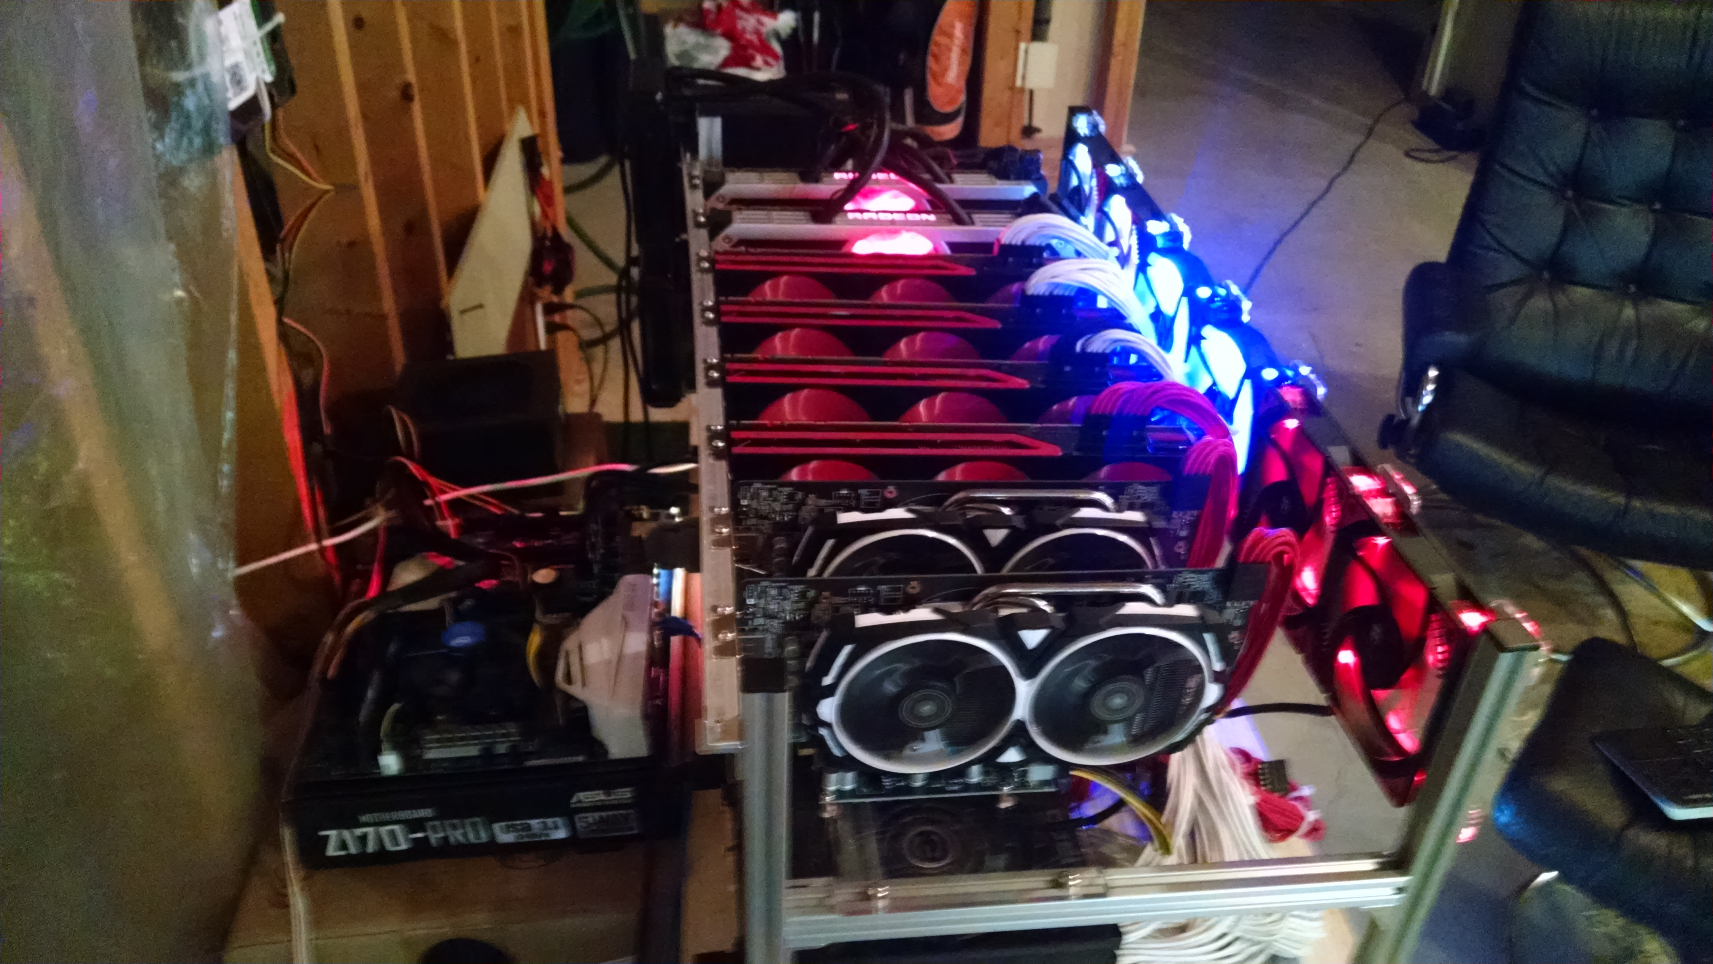

Slide 5

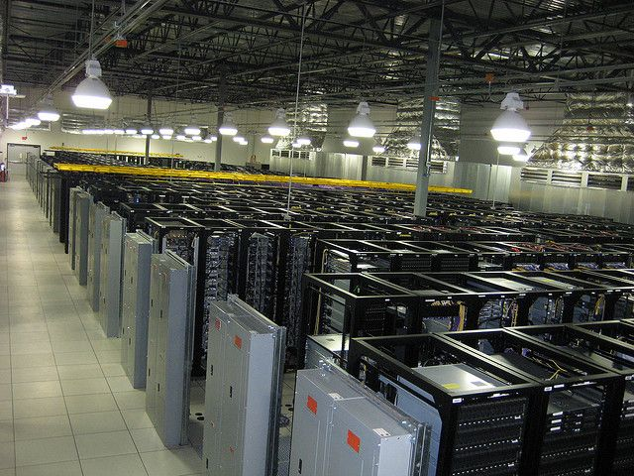
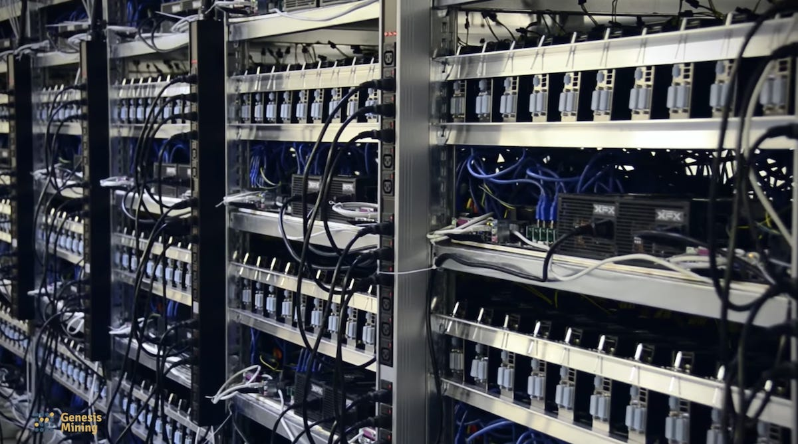

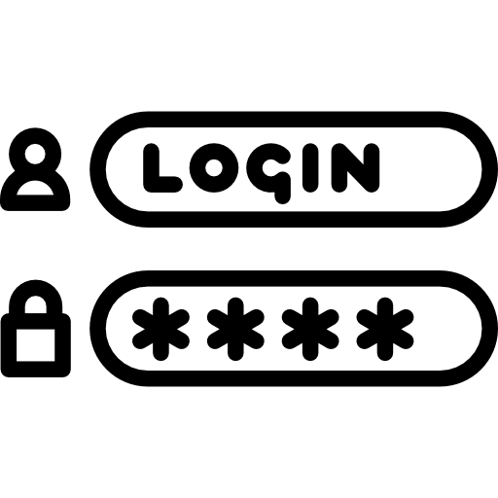

Slide 6
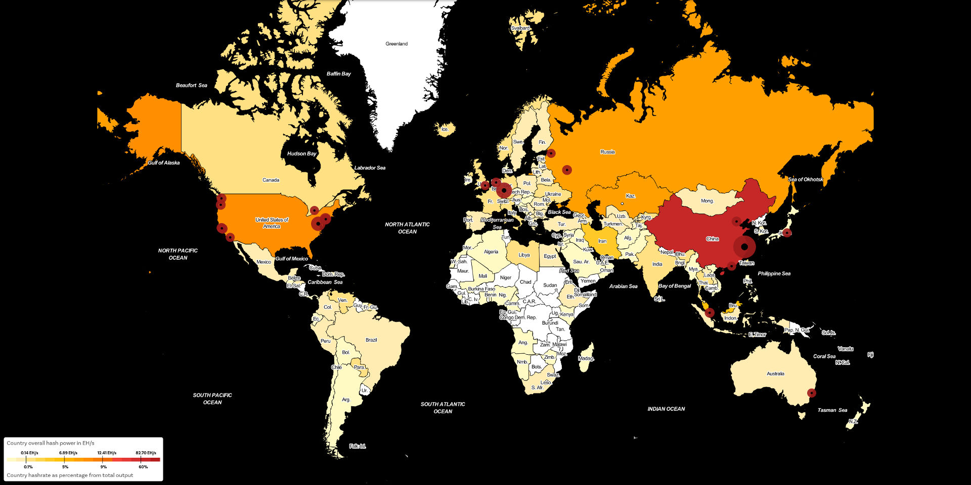
~1mm+

Slide 7
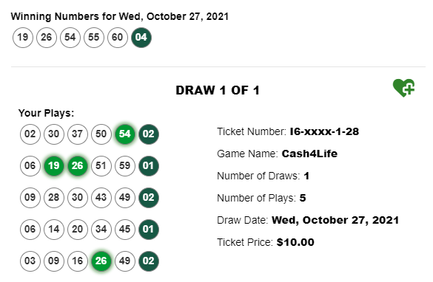

Proof of Work
Notes:
Latest BTC: Pr( 3.12513025e-34 ) === 1 in 3 billion billion billion million @ 19 leading zeros ever 10 min
Powerball : 1 in 292 million

Slide 8

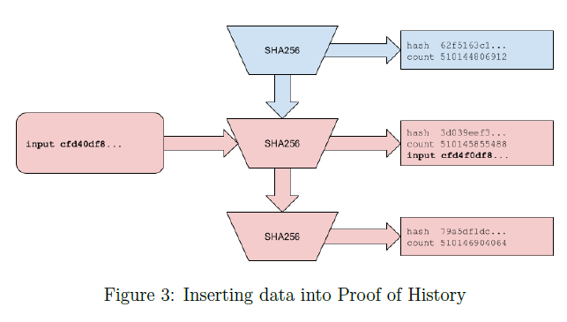
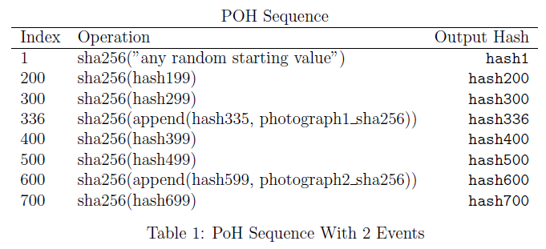
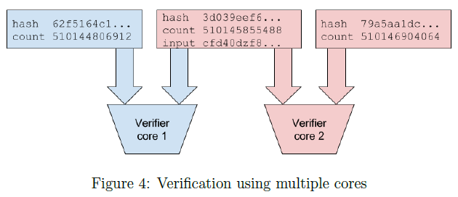

Slide 9

Fault Tolerance

Slide 10


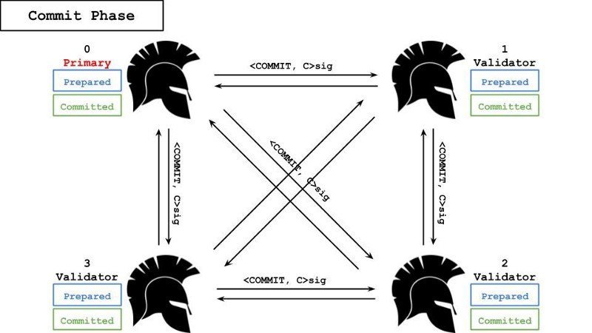



Slide 11
Sybil / Bing accts

Slide 12
What is a “fault” ?

Slide 13
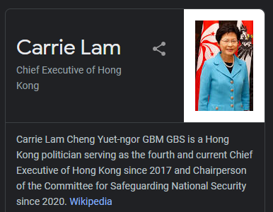


Slide 14

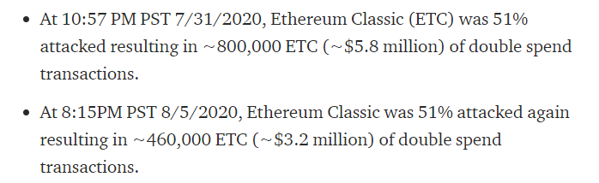
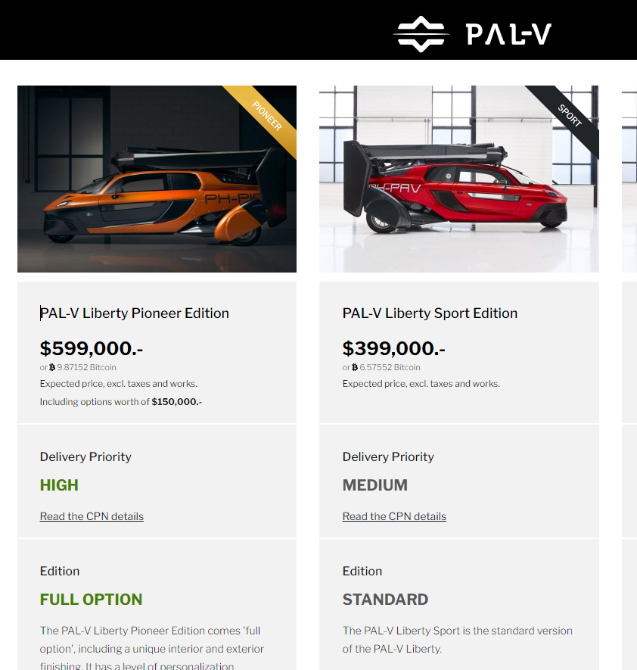
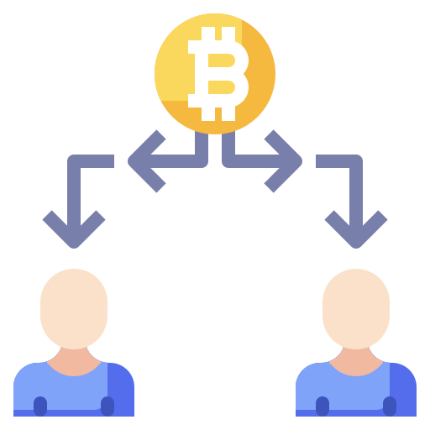

Slide 15
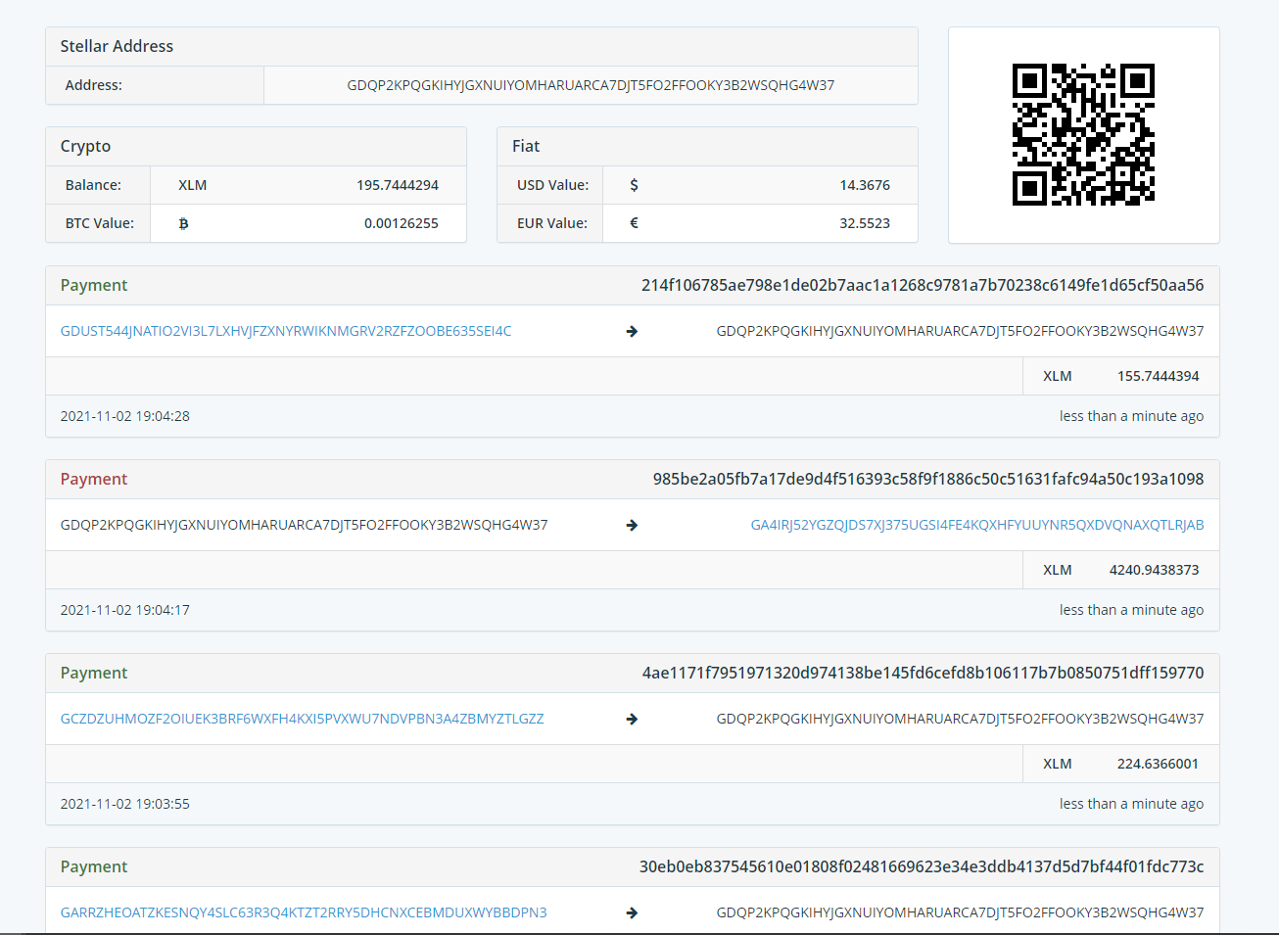
Chains vs. DAGs/FSM

Slide 16
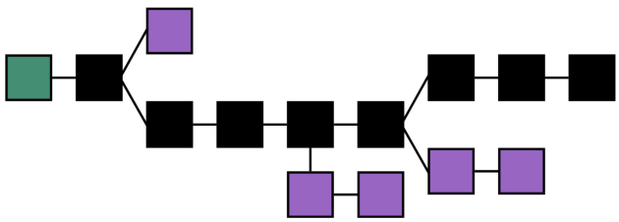

Slide 17









Domain Routing

Slide 18
Domain Routing

Slide 19
Domain Routing

Slide 20
Domain Routing

Slide 21







Collective Consensus

Slide 22
Types of consensus mechanisms
Classical
PoW
PoS (?)
Avalanche
DAG/TxnSets
Ledger/StateMachine

